Slide 1

Impact of Trade Imbalances on National Economies: Case Study of USA and China
INTERNATIONAL BUSINESS
Presented By: Gaby Al Halaby
To:
Dr. Rositta Kassis

Slide 2
International Trade and Economic Growth
International trade promotes access to larger markets and economic growth.
Supports specialization, innovation, and competition.
Enhances infrastructure and technology transfer, especially in developing nations.

Slide 3

Understanding Trade Balance and Trade Imbalance
Trade Balance:
The difference between a nation's exports and imports of goods and services.
Positive Trade Balance (Surplus):
Exports > Imports → More money coming in.
Negative Trade Balance (Deficit):
Imports > Exports → More money going out.
Why it Matters:
Persistent imbalances can signal deeper economic problems and impact long-term growth.

Slide 4
Importance of Studying Trade Imbalances
Imbalances highlight deeper economic issues.
Affect jobs, competitiveness, and global stability.
Essential for crafting effective trade and fiscal policies.

Slide 5
Project Objectives and Structure
Analyze causes and effects of trade imbalances.
Examine U.S.–China trade relations and conflicts.
Discuss policy responses and lessons for other nations.
Structure includes: Theories, Overview, Causes, Impacts, Comparative Product Studies, and Strategies.

Slide 6
Mechanisms of Currency, Tariffs, and Trade Policies
Currency devaluation boosts exports; overvaluation worsens deficits.
Tariffs protect local industries but may trigger retaliation.
Trade policies (FTAs, quotas, subsidies) shape competitiveness.

Slide 7
Role of International Institutions (WTO & IMF)
WTO: Promotes fair trade, resolves disputes, removes barriers.
IMF: Monitors trade imbalances, advises on policies, provides financial support.
Together, they promote global economic stability.

Slide 8
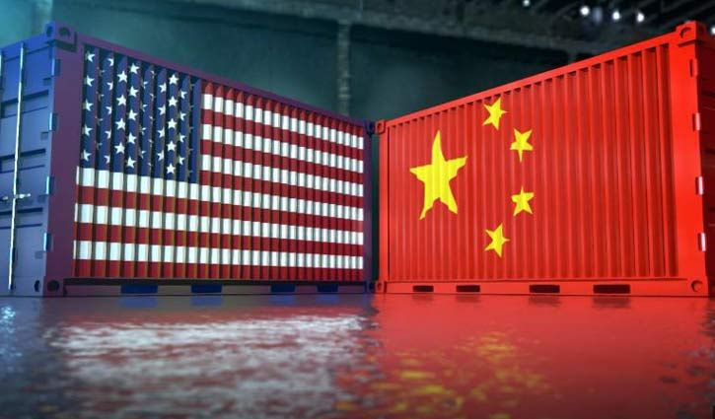
CAUSES OF TRADE INBALANCES
Trade imbalances happen because of deep problems in how economies are built, how people spend and save, and what governments decide to do.
The U.S. and China have major trade imbalances because of differences in their economies.

Slide 9



A- structural reasons:
1. Wage Differences
Workers in China earn much less than in the U.S., making Chinese goods cheaper.
2. Industry Specialization
China makes most of the world's consumer and electronic goods.
The U.S. focuses more on tech, finance, and services, so it imports a lot from China.
3. Currency Management
China keeps its money (Yuan) cheap compared to the U.S dollar to make its goods more affordable globally.

Slide 10


B- Consumption and saving behavior
1. American Spending Culture
Americans love to spend.
They save less and buy many cheap imported goods, mostly from China.
2. Chinese Saving Culture
Chinese people and the government save a lot.
They spend less on foreign goods and invest more in building factories and infrastructure.

Slide 11
C- policy choices
1. Tariffs and Trade Barriers
Both countries set tariffs on each other's goods during trade wars, affecting trade flow.
2. Government Subsidies
China gives big support to industries like steel and solar energy, making their products cheaper.
U.S. subsidies are smaller and mostly help farming and clean energy.
3. Joining the WTO
When China joined the WTO in 2001, its exports grew fast.
Some say China did not fully follow trade rules, causing more tensions.

Slide 12
D- TECHNOLOGY AND PRODUCTIVITY DIFFERENCES
Technology Transfers
Foreign companies had to share their technology with Chinese companies, helping China improve quickly.
2. Productivity and Innovation
The U.S. is highly productive because of better technology and automation.
China invested heavily to boost its own productivity and reduce costs.

Slide 13
Impact of Trade Imbalances
A. On the United States:
1. Loss of Manufacturing Jobs
Many American factories closed or moved overseas, causing job losses, especially in industrial areas.
2. Impact on Economy
The trade deficit hurts long-term growth but keeps prices low.
Over time, it could weaken the U.S. dollar.
3. Political Reaction
Trade deficits led to protectionist policies like tariffs and "Buy American" campaigns.

Slide 14
B. On China:
1. Fast Economic Growth
Exports helped millions of Chinese people get out of poverty and made China the second-largest economy.
2. Big Foreign Currency Reserves
China saved lots of U.S. dollars, giving it financial power worldwide.
3. Risk of Overdependence
China depends heavily on exports.
Global problems (like COVID-19) can hurt its economy, so China now tries to boost spending inside its own country.

Slide 15

Comparative Analysis – Electric Vehicles
Tesla (USA) vs. BYD (China)
Focus: Production, Export, Trade Policies, Market Share, Impact on Trade Balance

Slide 16
Production and Export Volumes
Trade Policies and Barriers
Tesla:
  1.8 million vehicles produced (2023).
  Mainly U.S. facilities + Gigafactory Shanghai (China).
  Exports to Canada, Europe, Asia.
BYD:
  3 million vehicles produced (2023).
  Production mostly in China.
  Aggressive global exports (Latin America, Europe, Southeast Asia).
Tesla:
Faced 25% tariffs during U.S.-China trade war.
Built Shanghai Gigafactory to avoid tariffs.
BYD:
Supported by Chinese government incentives.
Limited access to U.S. market due to tariffs.
Expanding in markets with fewer barriers (Latin America, Southeast Asia).

Slide 17
Market Share and Trade Flows
Impact on Bilateral Trade Balance
Tesla:
50%+ U.S. EV market share.
10–12% market share in China.
Mostly locally produced for Chinese market.
BYD:
35–40% Chinese EV market share.
Growing exports improving China’s automotive surplus.
Tesla:
Local production in China = No significant boost to U.S. exports.
BYD:
Exports directly from China.
Strengthens China’s trade surplus.
Key Insight: Localization vs. export-led strategies affect trade balances differently.

